Slide 1
Human Body Systems

Slide 2
Multi-cellular Organisms
Organisms that made up of many cells are called multi-cellular.
Multi-cellular organism depend of a variety of different kinds of cells to accomplish all the functions of living things.
Cell specialization: The development of cells in different ways to perform different tasks in an organism.

Slide 3
The levels of organization in a multi-cellular organism are individual cells tissues, organs, and organ systems.
Tissue: Similar cells grouped into units that perform a particular function.
Organ: Different types of tissue working together to perform a specific task.
Organ system: A group of organs that work together to perform a specific function.

Slide 4
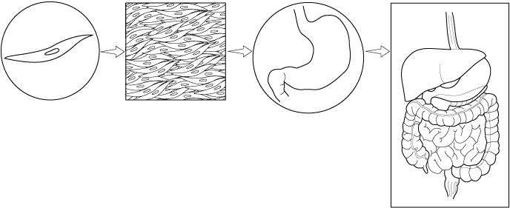
Levels of Organization of Multi-Cellular Organisms
Levels of Organization
Section 7-4
Muscle cell
Smooth muscle tissue
Stomach
Digestive system

Slide 5
Homeostasis
Homeostasis is the process by which organisms maintain relatively stable internal conditions despite a changing external environment.

Slide 6
Human Body Systems
There are 11 major human body systems
These 11 systems work together to maintain homeostasis in humans.

Slide 7
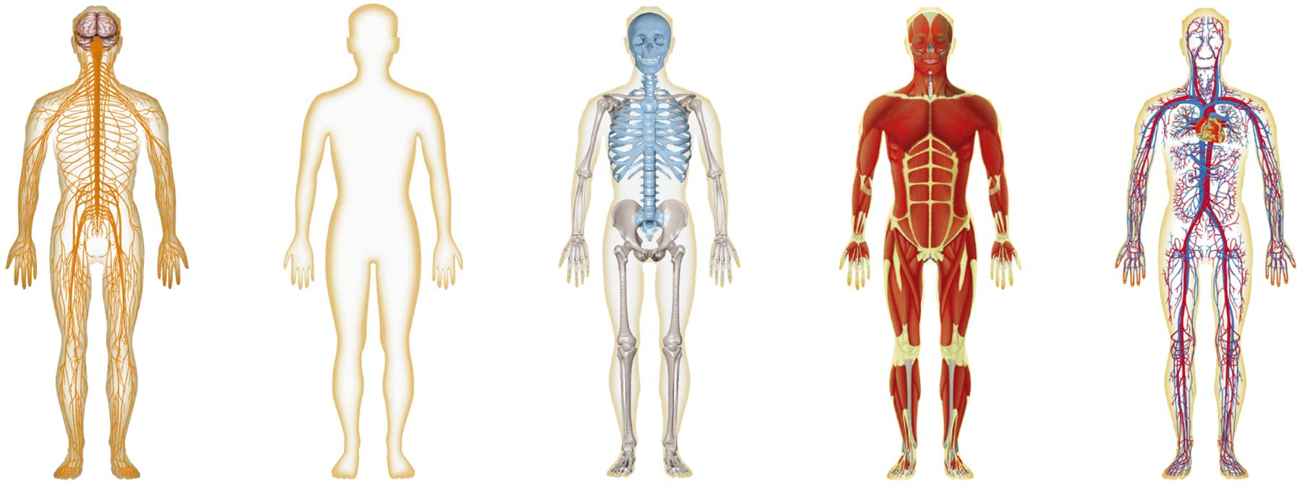
Figure 35-2 Human Organ Systems Part I
Section 35-1
Nervous System
Integumentary System
Skeletal System
Muscular System
Circulatory System

Slide 8
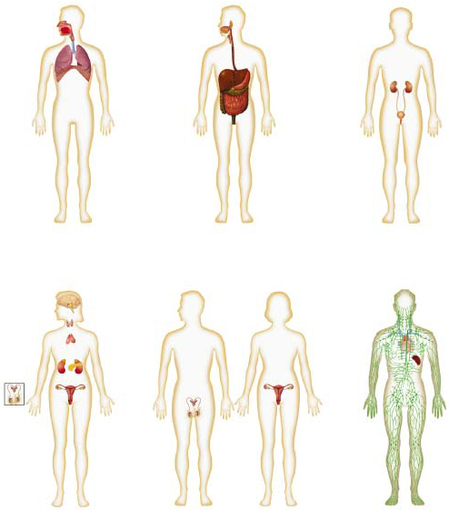
Figure 35-2 Human Organ Systems Part 2
Section 35-1
Respiratory System
Digestive System
Excretory System
Endocrine System
Reproductive System
Lymphatic/Immune Systems

Slide 9
Nervous System
The nervous system controls and coordinates the functions of the body and responds to both internal and external stimuli.
The messages carried by the nervous system electrical signals called impulses.
Impulses are carried by specialized cells called neurons.

Slide 10
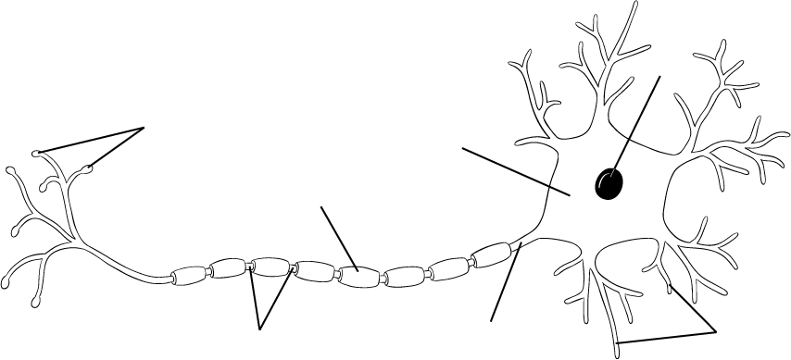
Neuron
A Neuron
Section 35-2
Nucleus
Axon terminals
Cell body
Myelin sheath
Nodes
Axon
Dendrites

Slide 11
Divisions of the Nervous System
The human nervous system is divided into two major divisions:
The central nervous system: Relays messages, processes and analyzes information. Made of brain and spinal cord
The peripheral nervous system: Connects all parts of the body to the central nervous system. Made of sensory and motor nerves.

Slide 12
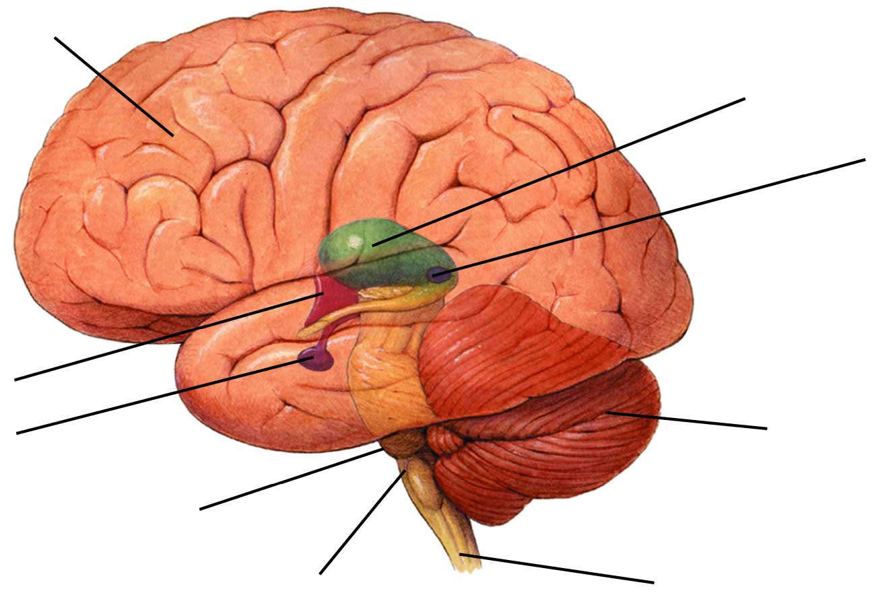
The Brain
Figure 35-9 The Brain
Section 35-3
Cerebrum
Thalamus
Pineal gland
Hypothalamus
Pituitary gland
Cerebellum
Pons
Medulla oblongata
Spinal cord

Slide 14
The Circulatory System
The human circulatory system consists of the heart, a series of blood vessels, and the blood that flows through them.

Slide 15
The myocardium is the muscle in the heart that pumps blood through the body.
The human heart has 4 chambers. The upper chambers are called the atrium and the lower chambers are called ventricles.
The right side of the heart receives oxygen poor blood from the body and sends it the lungs. The left side of the heart receives oxygen rich blood from the lungs and sends it to the body.

Slide 16
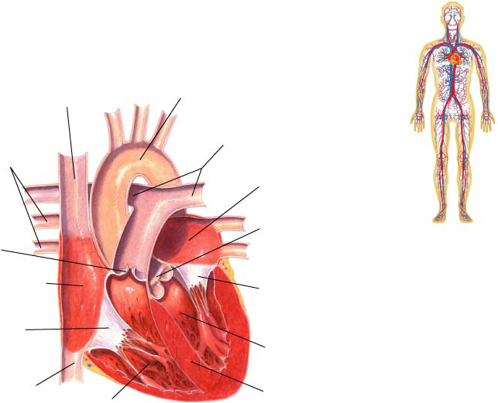
Figure 37-3 The Structures of the Heart
Section 37-1
Superior Vena Cava
Large vein that brings oxygen-poor blood from the upper part of the body to the right atrium
Aorta
Brings oxygen-rich blood from the left ventricle to the rest of the body
Pulmonary Veins
Bring oxygen-rich blood from each of the lungs to the left atrium
Pulmonary Arteries
Bring oxygen-poor blood to the lungs
Left Atrium
Pulmonary Valve
Prevents blood from flowing back into the right ventricle after it has entered the pulmonary artery
Aortic Valve
Prevents blood from flowing back into the left ventricle after it has entered the aorta
Right Atrium
Mitral Valve
Prevents blood from flowing back into the left atrium after it has entered the left ventricle
Tricuspid Valve
Prevents blood from flowing back into the right atrium after it has entered the right ventricle
Left Ventricle
Inferior Vena Cava
Vein that brings oxygen-poor blood from the lower part of the body to the right atrium
Septum
Right Ventricle

Slide 17
Circulation
As blood flows through the circulatory system it moves through 3 different types of blood vessels. Arteries, capillaries and veins.
Arteries carry oxygen rich blood away from the heart to the body. (opposite for pulmonary/lung circuit)
Capillaries carry blood from arteries to individual cells
Veins carry oxygen poor blood back to the heart. (opposite for pulmonary/lung circuit)

Slide 18
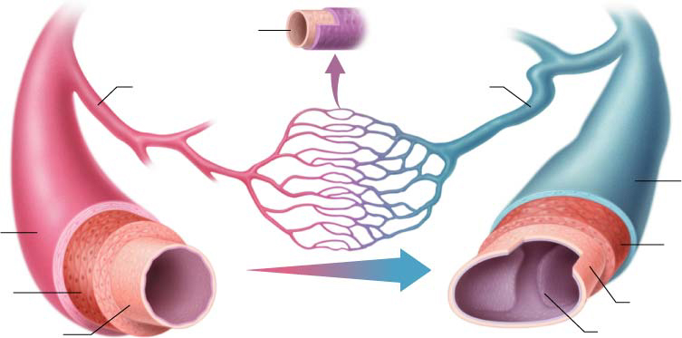
Figure 37-5 The Three Types of Blood Vessels
Section 37-1
Artery
Vein
Endothelium
Capillary
Arteriole
Venule
Connective tissue
Connective tissue
Smooth muscle
Smooth muscle
Endothelium
Endothelium
Valve

Slide 19
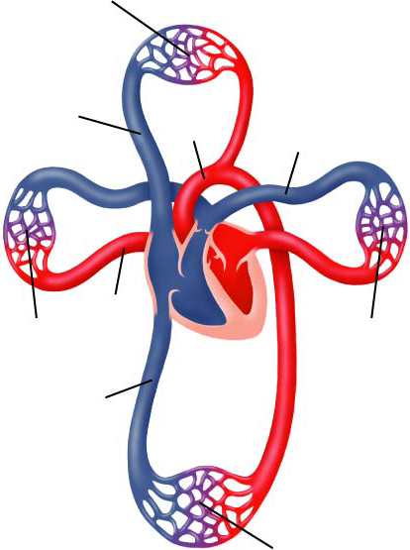
Figure 37-2 The Circulatory System
Section 37-1
Capillaries of head and arms
Superior vena cava
Aorta
Pulmonary artery
Pulmonary vein
Capillaries of right lung
Capillaries of left lung
Inferior vena cava
Capillaries of abdominal organs and legs

Slide 20
Blood Pressure
When the heart pumps blood through the arteries (beginning with ventricular contraction) it exerts force on the arterial wall. This is known as blood pressure.
When the heart contracts it increases blood pressure on the arterial walls. When it relaxes the blood pressure decreases.
Normal blood pressure 120/80

Slide 21
Cardiovascular Disease
High blood pressure and atherosclerosis are the two leading causes of heart disease
Atherosclerosis is the build of fatty tissues on the walls of arteries called plaque.
Atherosclerosis in the coronary arteries can prevent blood from getting to the muscles of the heart, which can cause the muscle to start die.
If enough muscle is damaged a heart attack occurs.

Slide 22
Stroke
Atherosclerosis can cause blood clots to form.
When one of clots break free it can then travel through the circulatory system.
Stroke occurs when one of these blood clots blocks a capillary in the brain.

Slide 23
Hypertension
High blood pressure can lead to a number of medical problems.
High blood pressure makes the heart work harder to circulate the blood.
Over long periods of time high blood pressure can weaken the heart and increase the risk of heart attack, stroke, or other circulatory diseases.

Slide 24
Disease
A disease is any change other than injury that disrupts normal body function.
Some disease are produced by agents such as bacteria, viruses, fungi or protists.
Other diseases are caused by environmetal factors, such as chemical exposure or UV light.
Some diseases are genetic.
Pathogen: Disease causing agents.

Slide 25
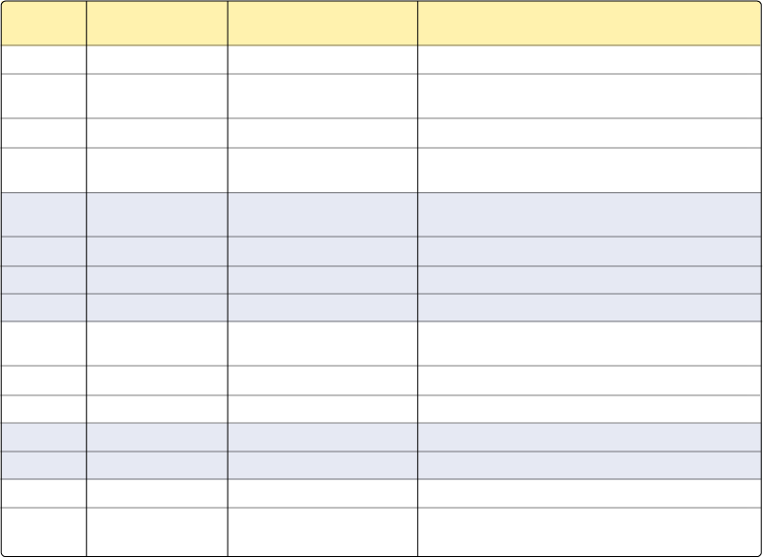
Pathogens and Disease
Section 40-1
Pathogen Types
Disease
Agent That Causes Disease
Method of Transmission
Viruses
Common cold
Rhinovirus
Airborne; direct contact with infected person
Influenza
Two types (A, B), plus subtypes
Airborne; droplet infection; direct contact with infected person
Chickenpox
Varicella
Airborne; direct contact with infected person
Measles
Paramyxovirus
Droplets in air; direct contact with secretions of infected person
Bacteria
Tuberculosis
Mycobacterium tuberculosis
Droplets in air; contaminated milk and dairy products
Meningitis
Neisseria meningitidis
Direct contact with a carrier
Cholera
Vibrio cholerae
Contaminated drinking water
Tetanus
Clostridium tetani
Contaminated wound; usually puncture wound
Protists
African sleeping sickness
Trypanosoma
Spread by tsetse fly
Malaria
Plasmodium
Spread by Anopheles mosquitoes
Amoebic dysentery
Entamoeba histolytica
Contaminated drinking water
Worms
Schistosomiasis
Schistosoma
Freshwater streams and rice paddies
Beef tapeworm
Taenia saginata
Contaminated meat
Fungi
Athlete’s foot
Imperfect fungi
Contact with infected person
Ringworm
Imperfect fungi
Exchange of hats, combs, or athletic head gear with infected person

Slide 26
Immune System
The function of the immune system is fight infection through the production of cells that inactivate foreign substances or cells.
The immune system has two general response categories. Non specific defense and specific defense

Slide 27
Non Specific Defense
These defenses do not discriminate between one threat and another.
First line of defense: Keep pathogens out of the body. The skin is primarily responsible of this.
Second line of defense: If pathogens enter the body the inflammatory response if activated

Slide 28
The Inflammatory response
The inflammatory response is a non specific response to damage or injury to bodily tissue.
During the inflammatory response white blood cell production rises. These cells fight infection.
Many of these white blood cells are phagocytes which will engulf and destroy bacteria.

Slide 29
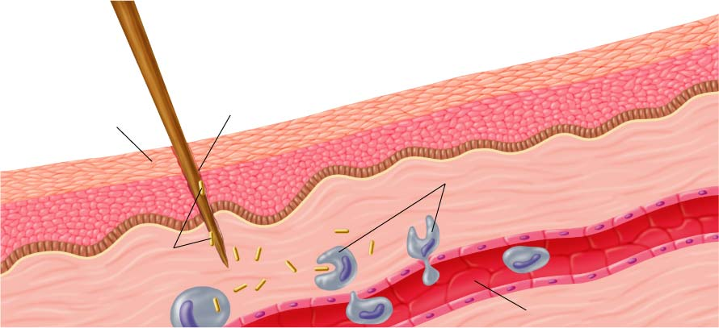
The Inflammatory Response
Section 40-2
Wound
Skin
Phagocytes move into the area and engulf the bacteria and cell debris
Bacteria enter the wound
Capillary

Slide 30
Specific Defense
IF a pathogen gets past the non specific defenses of the immune system, it will trigger a specific response that targets that type of pathogen.
A substance that triggers this response is called an antigen. Viruses, bacteria and other pathogens can serve as antigens

Slide 31
Humoral Activity
Antigens are recognized by B cells of the immune system.
These B cells start to produce proteins called antibodies
Antibodies will attack the antigens.
Some B cells become memory B cells and if that specific antigen ever returns the body can respond quicker.

Slide 32
Cell-mediated response
Once a pathogen has invaded a host cell the humoral response doesn’t work.
During cell mediated response T cells attack infected cells and destroys them.
There are 4 kinds of T cells involved in this process. Helper T cells, Killer T cells, suppressor T cells and Memory T cells

Slide 33
Vaccines
Vaccination: The injection of a weakened or destroyed pathogen to produce immunity.
Active immunity: The immune system produces antibodies in response to a antigen.
Passive immunity: Antibodies are introduced to the body.

Slide 34
The Reproductive System
The reproductive system is used to produce new individuals.
The male reproductive cells are made in the testes and the female reproductive cells are made in the ovaries.

Slide 35
The male reproductive system
The Function of the male reproductive system is to produce and deliver sperm cells.
Sperm cells are produced in the testes of a male. The testes are contained within the scrotum.
Sperm is stored inside of the epididymis. From there sperm cells are transported through the vas deferens to the urethra and then out of the body through the penis.

Slide 36
The Female Reproductive System
The main function of the female reproductive system is to produce eggs and prepare the females body to nourish and carry the developing embryo.
Eggs are produced in the ovaries and are released once a month. They travel through the fallopian tubes to the uterus and then out of the body if fertilization doesn’t occur

Slide 37
Fertilization
The process of joining a sperm cell and a egg is called fertilization.
The Fertilized egg is called a zygote.
Fertilization tends to occur in the fallopian tubes.
As the zygote moves through the fallopian tubes the zygote starts to undergo rapid cell division
After 4 days the embryo is a solid ball of 64 cells called a morula.
After 7 days the embryo is a hollow, fluid filled, ball of cells called a blastula or blastocyst and is ready to implant in the uterus

Slide 38
Early Development
The early stages of development include implantation, gastrulation and neurulation.
After implantation the embryonic cells begin to specialize in a process called differentiation.

Slide 39
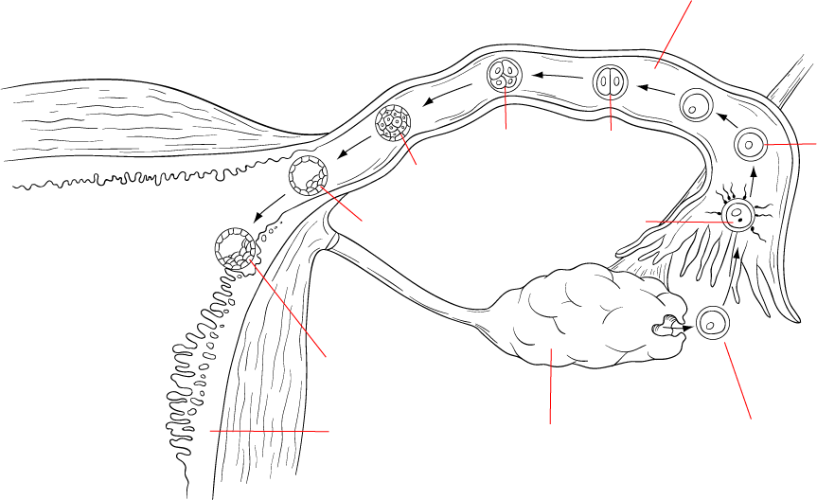
Fertilization and Implantation
Section 39-4
Fallopian tube
Day 3
Day 2
Day 1
Day 4
4 cells
2 cells
Zygote
Morula
Day 7
Blastocyst
Fertilization
Day 0
Implantation of blastocyst
Uterine wall
Ovary
Egg released by ovary

Slide 40
During gastrulation 3 distinct cell layers form: Ectoderm, endoderm and mesoderm.
After gastrulation, neurulation occurs. During neurulation the nervous system begins to form.

Slide 41
The placenta is a connection between the mother and developing embryo. The placenta is the embryo’s organ of respiration, nourishment and excretion.
The embryo is attached to the placenta by the umbilical cord
After 8 weeks of development the development the embryo is called a fetus.
After 3 months most of the major organs and tissues are fully formed.

Slide 42
Later Development
During the fourth, fifth and sixth months of development the tissues of the fetus become more complex and specialized and start to function.
During the last 3 months organ systems mature and prepare the developing fetus to survive on it own.

