Slide 1
Immune System
Day 1

Slide 2
Immune System
Research 3
Bio EOC
Don’t leave home without it!

Slide 3
What are we learning today?
Benchmark
Objectives
SC.912.L.14.52 Explain the basic functions of the human immune system, including specific and nonspecific immune response, vaccines, and antibiotics
I will identify and explain the basic functions of the human immune system, including specific and nonspecific immune responses.

Slide 4
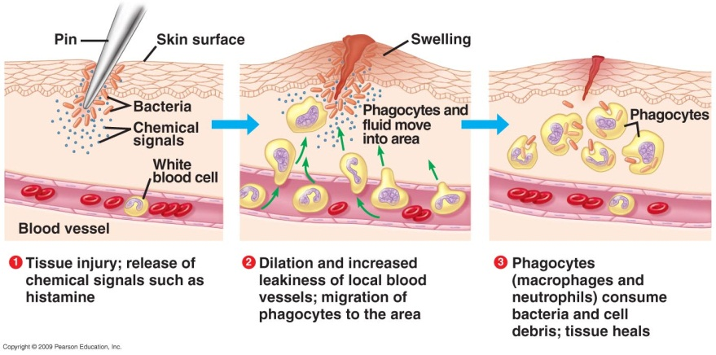
What is the essential question?
Why is the immune response considered a specific defense against pathogens, while the inflammatory response is considered a nonspecific defense?
Notes:
Answer: The immune response is targeted toward pathogens it remembers. Memory cells continue to patrol the body’s tissues, circulating through the blood and lymph for long periods of time and responding quickly against pathogens they recognize. The inflammatory response can inhibit the growth of pathogens and stimulate macrophage action, but the inflammatory response is not selective.

Slide 5
What are the basics?
Homeostasis is the ability of an organism to maintain a stable internal environment.
Diseases can disrupt this stability.
Your immune system is the organ system that protects your body from disease.
Your body has three different lines of defense against pathogens, or disease causing agents.
Notes:
To the Teacher: Take time to explain the importance of the circulatory system to the immune system. Ask students why they think the immune system could not function properly without the assistance of the circulatory system? If a pathogen does get into the body, the circulatory system helps fight the infection by transporting the immune system’s specialized cells to the source of infection

Slide 6
What are the two types of immune defense?
The immune system includes two general categories of defense mechanisms against infection.
Nonspecific defenses guard against infections by keeping most things out of the body.
Specific defenses track down harmful pathogens that have managed to break through the body’s nonspecific defenses.
Notes:
To the Teacher: Refer to essential question as students identify the differences between the two types of defense.

Slide 7
1st Line of Defense: Barriers to Infection
To cause disease, a pathogen must invade the body.
Your body has barriers to keep this pathogens out.
Skin provides a protective barrier.
Mucous membranes line up interior surfaces that come into contact with the environment.
Pathogens that are swallowed are likely to be destroyed by your stomach acids.
Sweat and tears contains salts, acids, and enzymes that help kill pathogens in your skin and eyes.
Notes:
To the Teacher: Ask students for the name of the structure in the pictures. Some students will recognize the Great Wall of China. Add a few factoids like it is over 1500 years old and it is the only man-made structure that can be seen from outer space. Ask students to explain why they think the Chinese built the wall? What organ in our body have a similar function?

Slide 8
2nd Line of Defense: Inflammatory Response
The inflammatory response is the body’s response to tissue damage.
As soon as pathogen enters your body, damaged tissue releases chemical signal.
Blood vessels expand. What is a consequence of this?
Plasma carries macrophages that engulf and destroy pathogens during phagocytosis
If infection persists, body may increase temperature resulting in a fever. Why?
Notes:
which attracts
To the Teacher: Using the information on this slide or the animation linked to the image (click on the far right side of image), have students make a graphic organizer in which they summarize the stages of the inflammatory response. You may ask students to include in their organizers the cause-and-effect relationships of the inflammatory response. A sample graphic organizer is shown below:
Inflammatory response
white blood cells
damaged or infected cells
chemical alarm signals
blood vessel dilation
temperature increases
increased capillary permeability
is triggered by
which release
which cause
which causes
swelling
which causes
suppresses bacterial growth
which causes
which
consume invading pathogens
which

Slide 9
Inflammatory Response
__6_ The temperature of the area around the injury increases suppressing bacterial growth.
__2_ Signals cause more fluid than normal to leak out of capillaries near the injury and swelling results.
__5_ Some cells responding to signals dilate blood vessels, causing more blood to flow in, and the area reddens.
_4__ WBC attack invading pathogens and consume dead and infected cells.
_1__ Damaged or infected cells release chemical alarm signals.
_3__ Attracted by chemical alarm signals, WBC move from the blood into the injured area through the walls of the swollen leaky capillaries.
Notes:
To the Teacher: This slide lists the steps that occur in the inflammatory response. Have students work with a partner to put the steps in the correct order by writing in the numbers 1–6 . You can have prepared copies of this activity on paper for students to paste it in their science notebooks.
_6_ The temperature of the area around the injury increases suppressing bacterial growth.
_2_ Signals cause more fluid than normal to leak out of capillaries near the injury and swelling results.
_5_ Some cells responding to signals dilate blood vessels, causing more blood to flow in, and the area reddens.
_4_ WBC attack invading pathogens and consume dead and infected cells.
_1_ Damaged or infected cells release chemical alarm signals.
_3_ Attracted by chemical alarm signals, WBC move from the blood into the injured area through the walls of the swollen leaky capillaries.

Slide 10
3rd Line of Defense: Immune Response
The immune response attacks specific pathogens using specialized cells and proteins.
T cells are white blood cells that attack and kill harmful bacteria.
B cells are white blood cells that make antibodies.
An antibody is a Y-shaped protein that attaches to a specific foreign substance, known as an antigen.
bind to the pathogen's membrane proteins
cause pathogen to clump together
weaken the pathogen's membrane
Notes:
To the Teacher: Have students who have had chickenpox raise their hands. Have them keep their hands raised if they had it more than once. Ask them to explain why most, if not all, hands went down in response to the second question.

Slide 11
What are we learning today?
Benchmark
Objectives
SC.912.L.14.52 Explain the basic functions of the human immune system, including specific and nonspecific immune response, vaccines, and antibiotics
I will describe how the human immune system responds to vaccines and/or antibiotics.

Slide 12
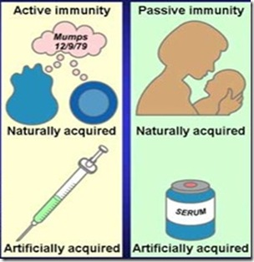
What are the types of immunity?
Active Immunity
Passive Immunity
Results from exposure to a specific pathogen
Naturally
Vaccination
B cells remain capable of producing antibodies specific to that pathogen reducing the chance that the disease could develop a second time
A vaccine is a weakened form of a pathogen.
Created by transferring antibodies made by one organism into another
Snake bite
Often acquired before birth or during nursing

Slide 13
How does immunity develop?
Once a person is exposed to a pathogen or vaccine, it triggers the immune system to make antibodies.
If the person is exposed to the same pathogen again, the immune system will respond quicker, with more intensity, and duration
Your body will get rid of the infection before you feel sick!!

Slide 14
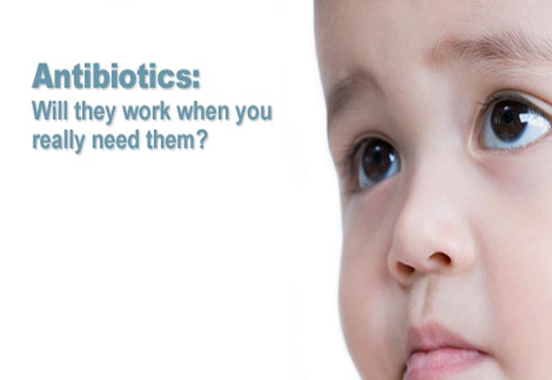
What are antibiotics?
Antibiotics are drugs used to fight bacterial infections
Kill or prevent their reproduction
Antibiotic resistance has become a problem in many parts of the world.

Slide 15
Check Your Understanding
Question 1
Question 2
Which of the following is not part of the body’s first line of defense against disease?
vaccine
skin
mucous membrane
tears
Which substance produced by the immune system is involved in both active immunity and passive immunity?
antibiotic
antibody
vaccine
mucus

Slide 16
Check Your Understanding
Question 3
Question 4
How do macrophages protect you from disease?
They prevent pathogens from entering your body
They prevent bacteria from reproducing
They engulf and destroy pathogens
They teach your immune system to make antibodies
By which process can a person acquire active immunity to a disease?
healthy eating
treatment with antibiotics
vaccination
following hygienic procedures

Slide 17
Check Your Understanding
Question 5
Question 6
Antibiotics are used to treat some infectious diseases. Which pathogens cause these diseases?
bacteria
viruses
toxins
fungi
By which process does your immune system respond to tissue damage?
phagocytosis
immune response
inflammatory response
allergic reaction

